Slide 1
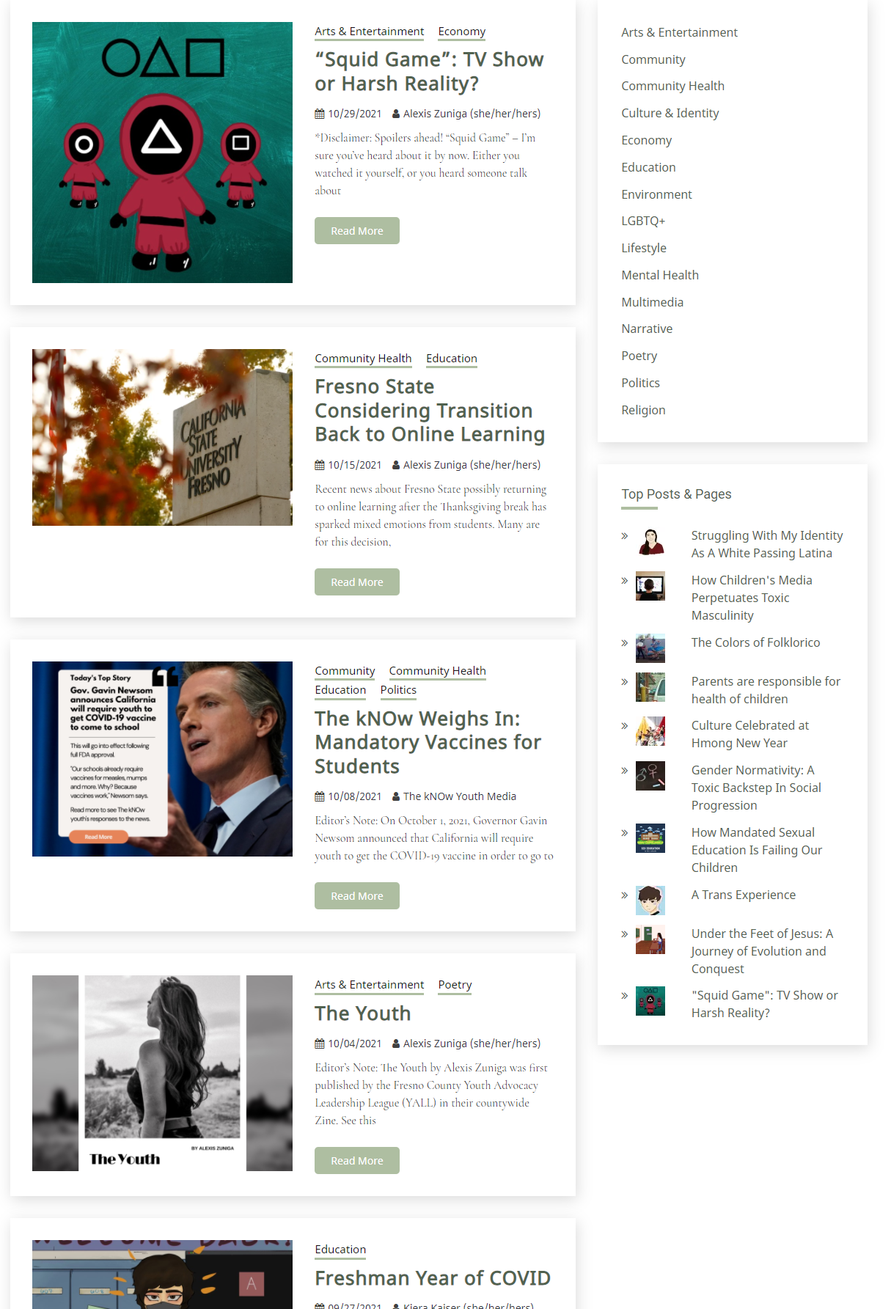
The kNow and How Social Media Use Affects Literacy Development
Learning and Community Impact
What I took and noticed from participating in this organization is that social media gives youth this powerful platform that allows them to not only engage with media literacy, but allows them to participate in civic engagement. Youth are able to be vastly creative using social media to voice their concerns and opinions that they would otherwise not be able to anywhere else. This tackles this overarching issue of youth not being heard and being drowned out by adults. I learned to be one who cooperates, instead of adding on to the drowning of youth ideas, especially in regards to my teaching philosophy of which changed and I will seek to be more conscious to make sure my students words are their own. I am also using this learning to do further research on youth social media use and its affect on literacy develop because I was intrigued in how social media use has sprouted in our society as a tool and how it is it’s own form of literacy
How the community benefited from my service learning is that I helped give youth a positive avenue to openly express themselves without fear of drowning or delusion of their own ideas/concepts. Even though the impact may not be widely visible, the practice of allowing youth to freely express their voice leaves a positive imprint on those individuals and also to future youth as well going into my own teaching career.
Presenter: Alexander J. Abraham
Service Learning Information:
The kNow Youth Media
Lead Coordinator: Johnsen Del Rosario
Service Learning Activities/Issue Addressed:
In the kNow Youth Media Organization we as volunteers helped assist the organization with propelling youth voices in regards to digital media being produced by them. What this means is that we helped give ideas to youth in regards to article/opinion pieces, helped youth digest their thoughts, and provided 1st edits to their ideas.
The organization as a whole gives youth a platform to voice their concerns and opinions about events going on in their community and overall society.

