Slide 1
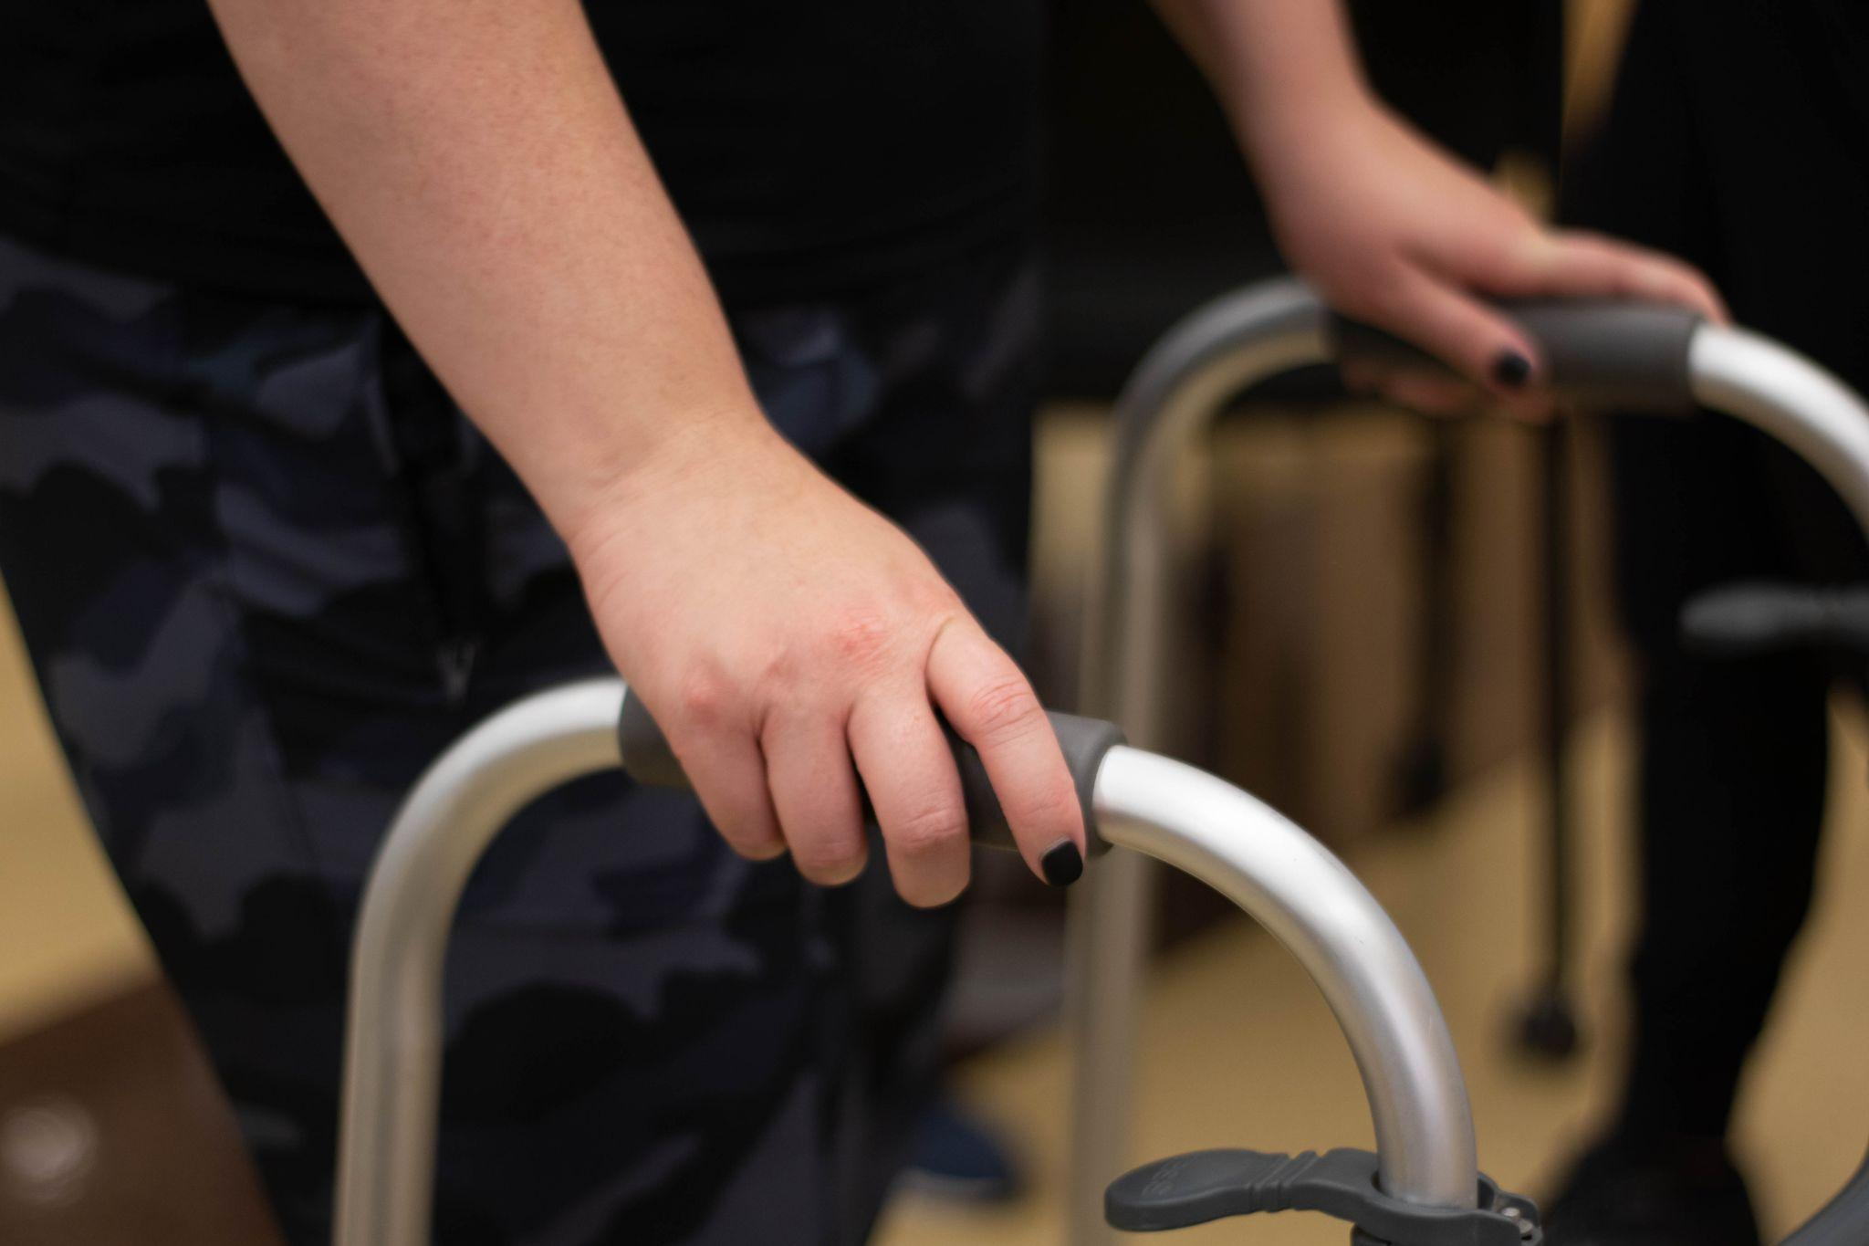
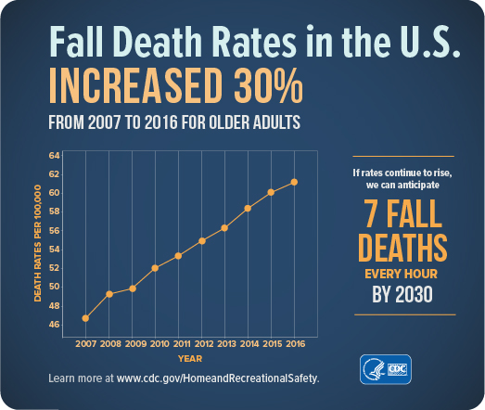
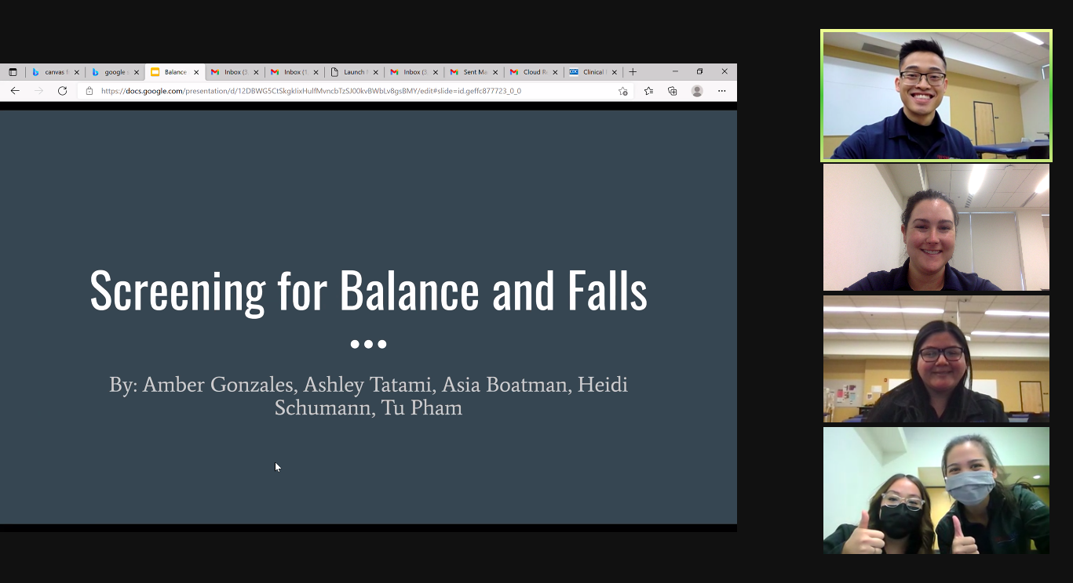
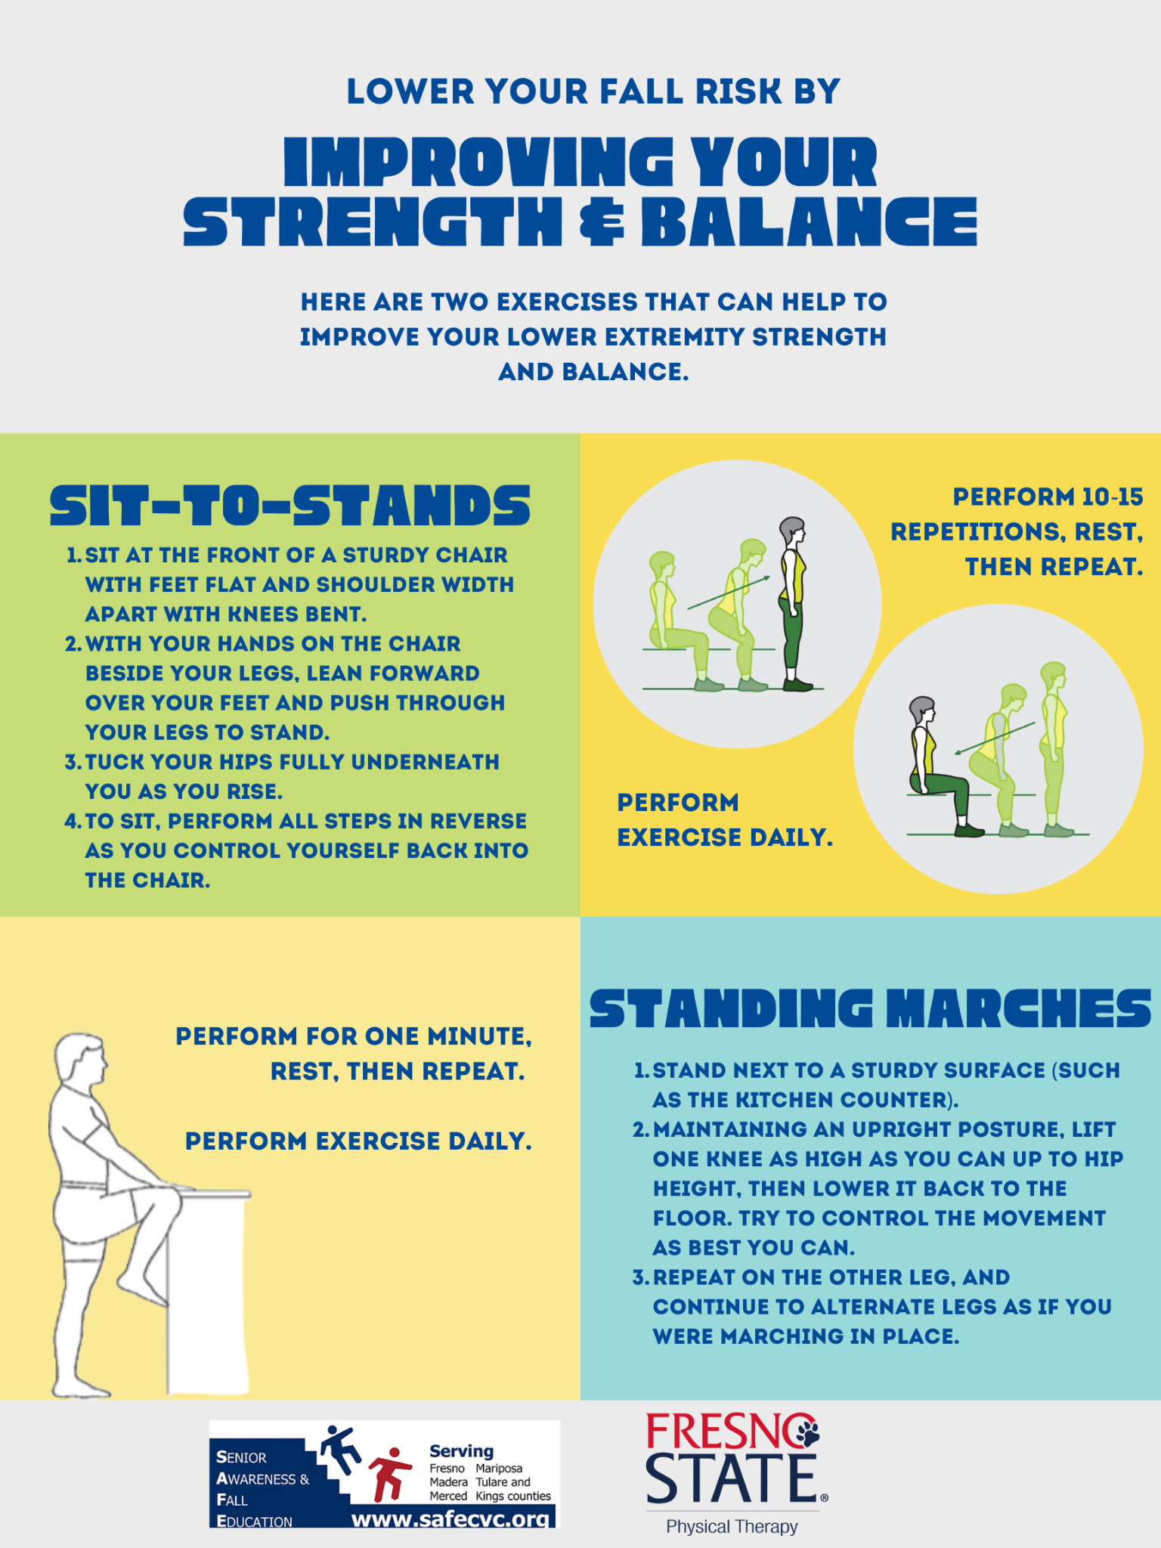
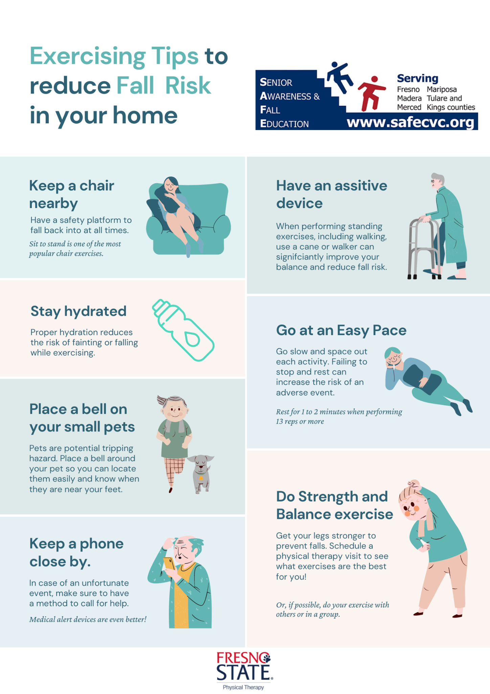
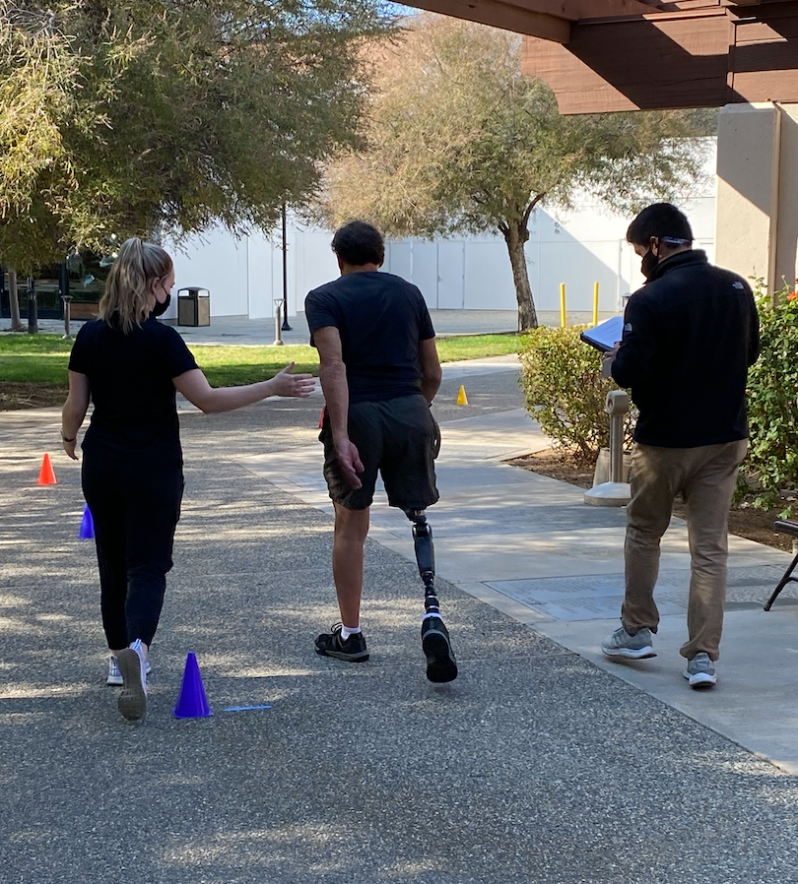
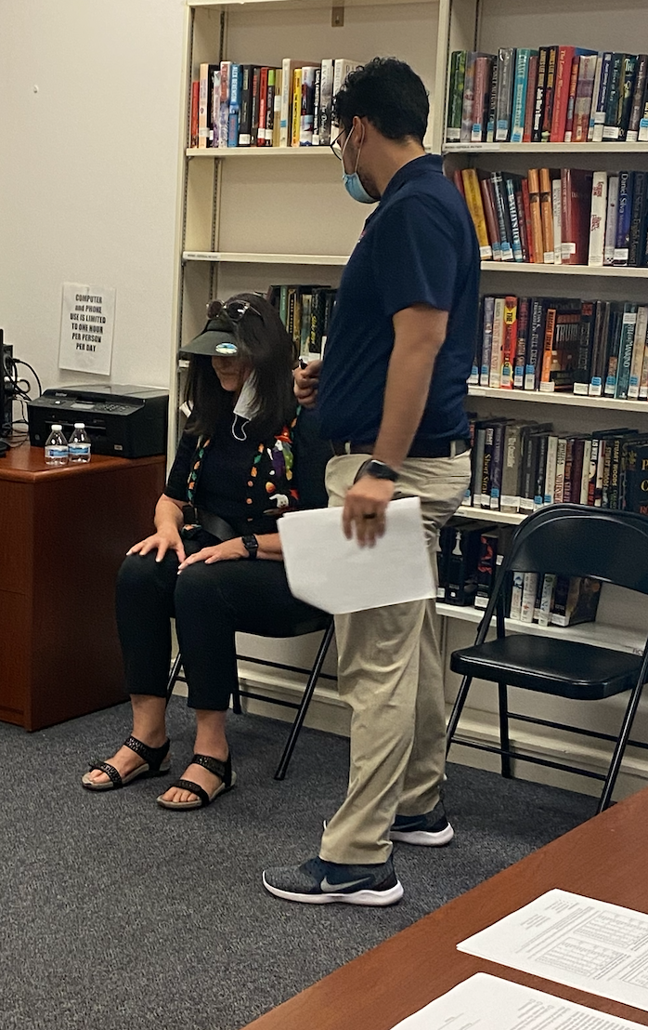
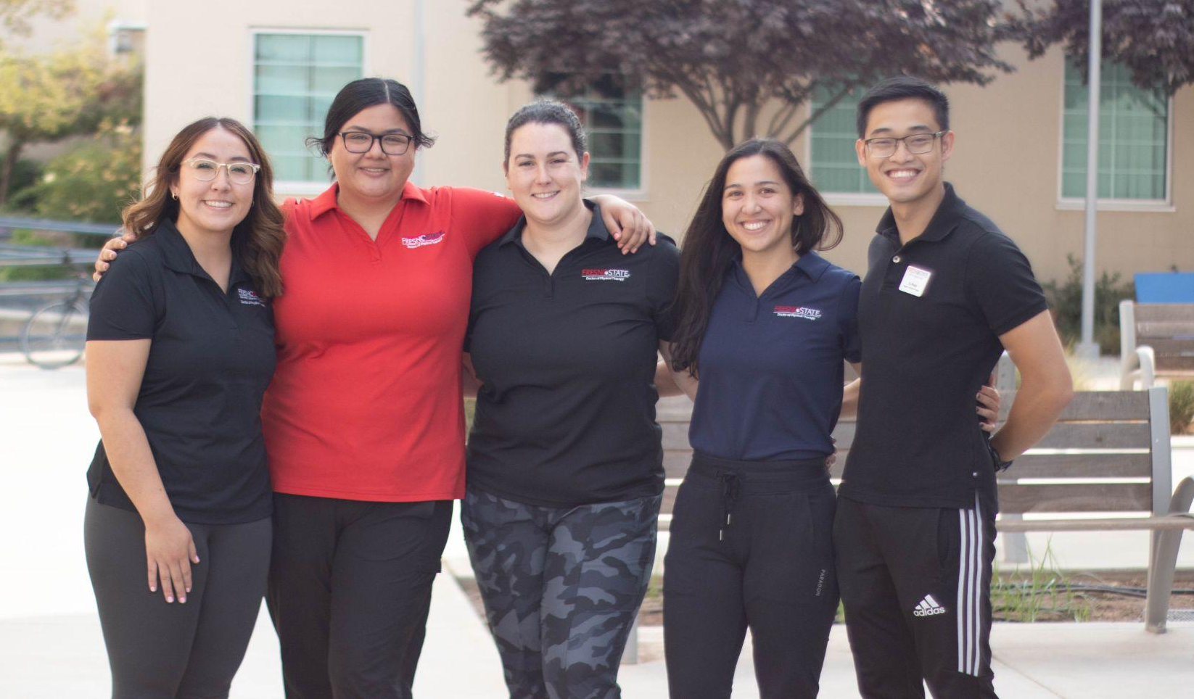
S.A.F.E. Fall Prevention Awareness
Ashley Tatami SPT, Asia Boatman SPT, Amber Gonzales SPT, Tu Pham SPT, & Heidi Schumann SPT with S.A.F.E Committee
Department of Physical Therapy
California State University, Fresno
Background
Each year 1 in 4 adults over the age of 65 fall. These falls can be costly, both in terms of financial burden and physical injury. Three million older adults require ED attention due to fall-related injuries. Falls are the most common cause of traumatic brain injuries (TBIs) and are responsible for 95% of hip fractures in older adults. In 2015, it was estimated that the total medical costs of falls exceeded $50 billion. These numbers become even more devastating when we take into account that falls can be prevented in most cases. As healthcare workers, it is our responsibility to both educate and advocate.
Reference: Facts about falls. Centers for Disease Control and Prevention. https://www.cdc.gov/falls/facts.html. Published August 6, 2021. Accessed November 8, 2021.
Abstract
In order to decrease fall risk in older adults in the Fresno community, the students mentored 2nd year Fresno State DPT students on conducting a thorough fall screen exam. The students created a video that was disseminated to the public to increase awareness of fall risks in the home. Infographics were also created to be posted to social media in order to educate the public about falls and how to decrease the risk of falling. This was done as part of the PHTH 565S Community Wellness course.
Screening for Balance and Falls
Goal: Create a presentation to provide mentorship to 2nd year DPT students to be able to properly administer the appropriate outcome measures for the fall and balance screen
Fall and Balance Screening Stations Reviewed:
Station 1: Vitals (BP, HR, RR)
Station 2: 10 M Walk Test (10 MWT)
Station 3: Time Up and Go (TUG)
Station 4: 30 Second Sit to Stand
Station 5: Functional Reach Test
Fall Prevention Handouts & Videos
Fresno State DPT students collaborated with the S.A.F.E. committee members to discuss ideas and focus points of the fall and balance screening
3rd year Fresno State DPT students created infographics and educational videos with useful tips and advice on home safety and fall prevention for older adults o upload on the S.A.F.E. social media platforms throughout Falls Prevention Awareness Week (September 20th 2021- September 24th, 2021)
Promote the free fall and balance screening clinic provided by Fresno State DPT students and S.A.F.E. (October 28th, 2021)
Reflection
This project allowed the students to learn more about preventative care and how to educate the older adult population to help prevent falls, including identification of common hazards in the home, safe practices, and risk factors to be aware of. The project also gave the students an opportunity for mentorship, as they were able to create a pre-recorded video and presentation to teach other DPT students how to screen for increased fall risk.The students learned what to look out for while screening the older adult population through this process, furthering our clinical skills. Twenty-six older adults were able to participate in the Fall and Balance Screening.
For questions or additional information please contact:
Dr. Jennifer Roos PT, DPT, GCS
jroos@csufresno.edu

