Slide 1
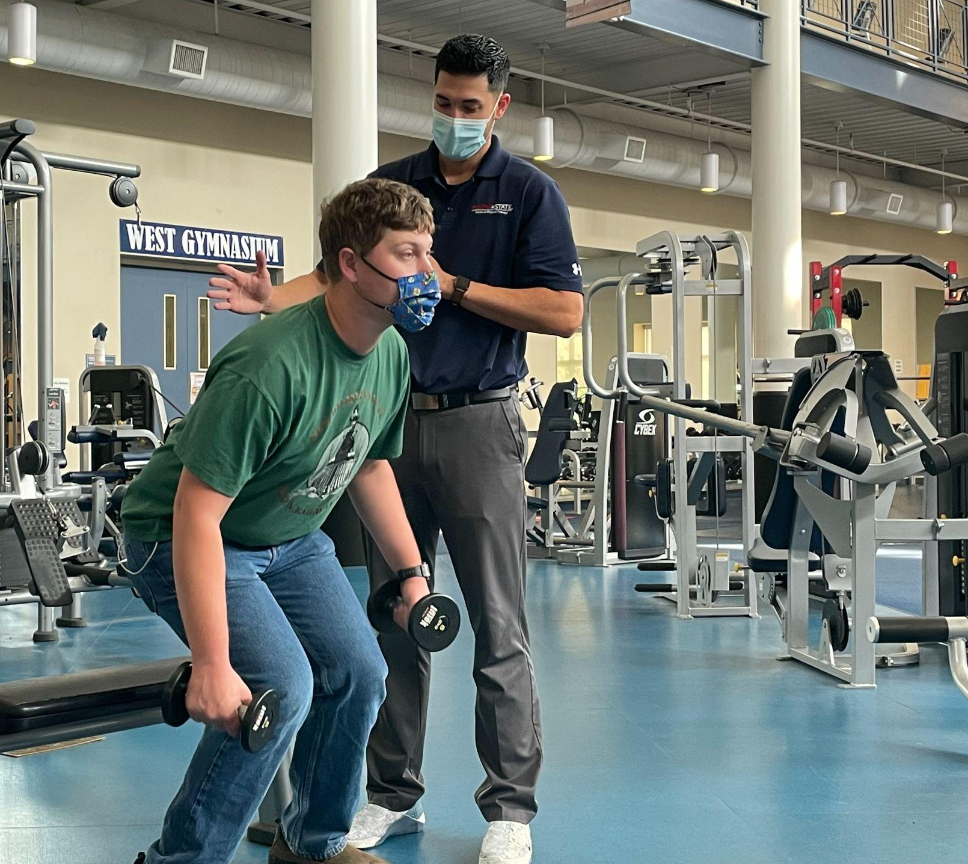
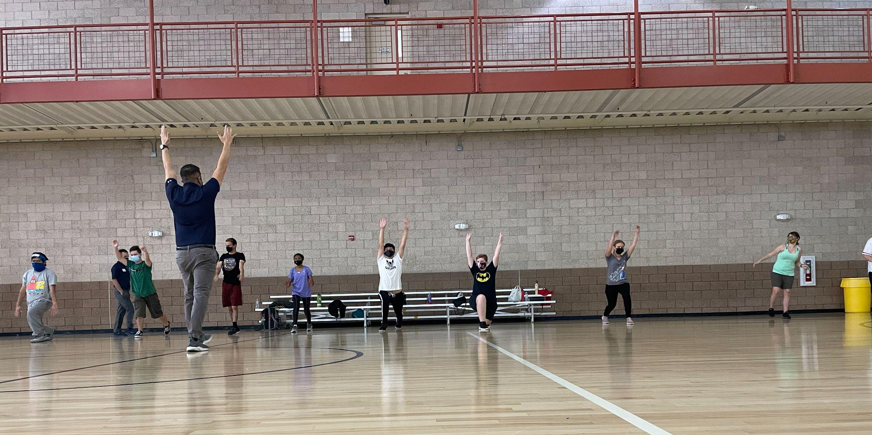
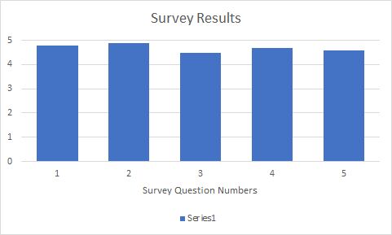
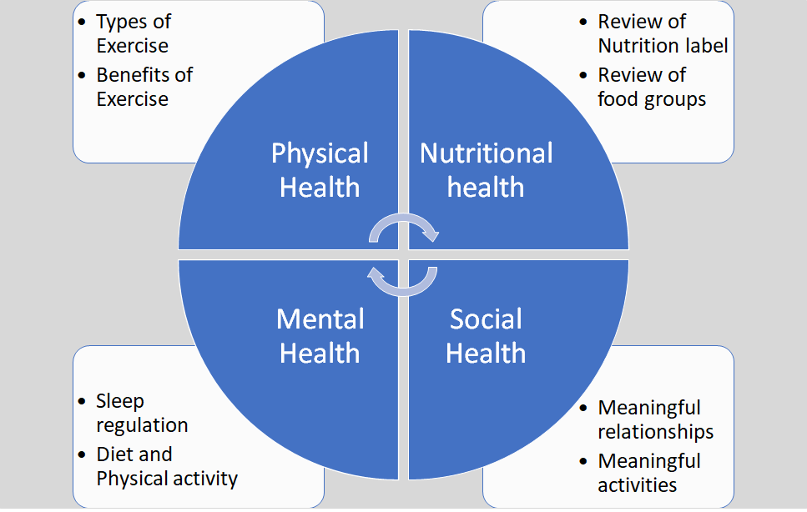
Weights with Wayfinders
For questions or additional information please contact:
Adam Jensen and adamlj@mail.fresnostate.edu
Jonah Allen SPT, Adam Jensen SPT, Ryan Martinez SPT, Sereno Esponilla SPT, Jennifer Roos, PT, DPT, GCS
Department of Physical Therapy
California State University, Fresno
Background^{1,2}
Purpose Statement
Intellectual disability (ID) is a term that describes a person who has certain limitations in cognitive functioning, social communication skills, and self-care skills. In the US, approximately 6.5 million people have an ID. Literature shows that high amounts of adults with ID do not meet (58-89%) recommended physical activity recommendations per the ACSM including 150 min/week of moderate or 75 min/week of vigorous intensity of physical activity
To provide information on the benefits of health and wellness to college students with ID involved in Fresno State’s Wayfinders program. Additionally, the purpose was to provide hands-on demonstration of exercises to improve technique, encourage confidence in performance of exercise and emphasize the importance of exercise in daily routines.
Interventions
Demographics and Data
Objective: Provide examples of aerobic and anaerobic exercises using body weight and gym equipment
Duration: 2 hours
Intensity: Self-selected; Emphasis on proper form and execution
Dynamic warm-up: 15 minutes
3 Stations, 20 minute intervals
Aerobic
Upper extremity anaerobic
Lower extremity anaerobic
Education on other physical activities: 20 minutes
Cool Down Stretch: 5 minutes
Total Participants: 10
Average Age: 19
Gender: Females: 4 ; Males: 6
Education Provided
Acknowledgement
Post Exercise Survey:
Following today’s event, I feel more confident in my ability to participate in exercise.
Following today’s event, I will make health & wellness a priority in my life.
Following today’s event, how likely are you to participate in exercise consistently?
The exercises and activities were challenging but manageable.
What is the likelihood you will recommend this event to you peers?
Thank you to our campus community partners at Wayfinders for joining us in participating in this event.
Notes:
Poster considerations:
Colors can be changed but should be appropriate combination of Fresno State colors only (red, blue, gray, white – per website)
Use of the school logo – ONLY 1 logo can be placed on a presentation. You can choose the Fresno State “color” or all “white” version seen in this template. Please DELETE the other one!
You can change the background colors, move them around, change their size, add more boxes – this is only here as a GUIDE for you. Get creative – we don’t want all of our projects looking exactly the same!
Include pictures, charts, graphs, pics of you and your zoom meeting supervisor/student team or pic of a zoom presentation. If you attended a location or met with any members of your team in person and you use a pic – think A) is it appropriate? Am I following socially distant guidelines? B) do the people in the picture consent for sharing?
Request use of logo from your community partner – you just need to let them know you are using a representation of their business logo, website/social media picture/title, etc to share on your poster (for example if you worked with a school district – you’d like to share their school logo from website, etc)
If you are working with another course on F.S. campus – you cannot use another F.S. Logo – but you can have a pic with members of the team socially distanced, or via zoom, and list name of class somewhere in your write up sections
Acknowledgement/Thank You section – it goes a long way to thank your community business partner for taking time to share information or expose you to an event, etc… for the purpose of completing this project!
Don’t forget to submit poster through canvas or during group advising for review before you submit it for the symposium!
Intellectual disability (ID) is a term that describes a person who has certain limitations in cognitive functioning, social communication skills, and self-care skills. In the United States, approximately 6.5 million people have an ID. Literature shows that high amounts of adults with ID do not meet recommended physical activity (PA) recommendations per the ACSM including 150 min/week of moderate or 75 min/week of vigorous intensity of PA; or strength training recommendation of all major muscle groups 2 or more times per week. Promotion of health and wellness through physical, mental and social aspects can lead to an overall improvement in lifestyle, decrease complications from a sedentary lifestyle, and decrease stress in all adults, but also in adults with ID.
https://www.ncbi.nlm.nih.gov/pmc/articles/PMC5750921/
Previous studies [13,14,15,16] report that adults with intellectual disabilities (ID) have high rates (58–89%) of not meeting physical activity (PA) recommendations which stipulate that adults with disabilities, who are able to, should perform 150 min of moderate-intensity physical activity per week or 75 min a week of vigorous-intensity physical activity, or an equivalent combination of moderate and vigorous-intensity aerobic activity [17].
https://www.specialolympics.org/about/intellectual-disabilities/what-is-intellectual-disability
Approximately 6.5 million people in the United States have an intellectual disability.
Intellectual disability (or ID) is a term used when a person has certain limitations in cognitive functioning and skills, including communication, social and self-care skills.

