Slide 1
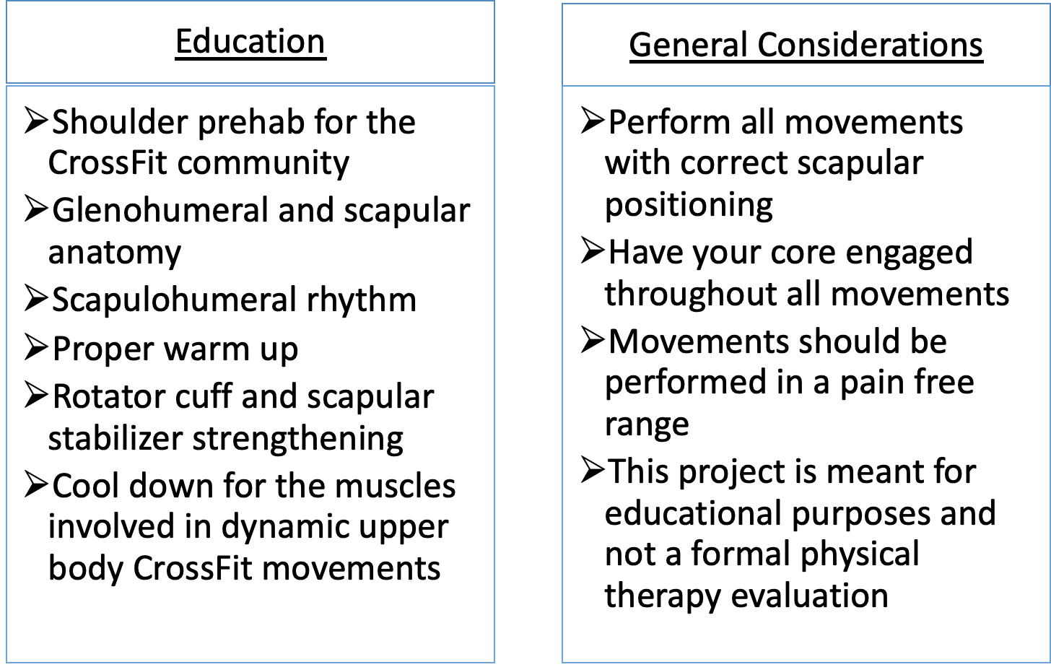
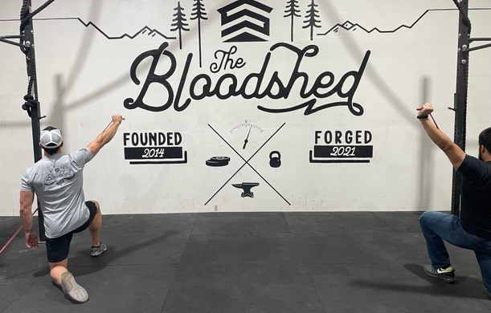
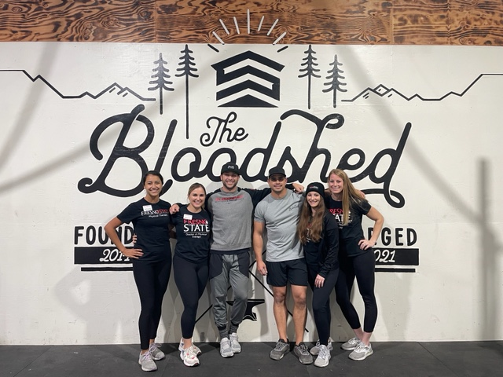
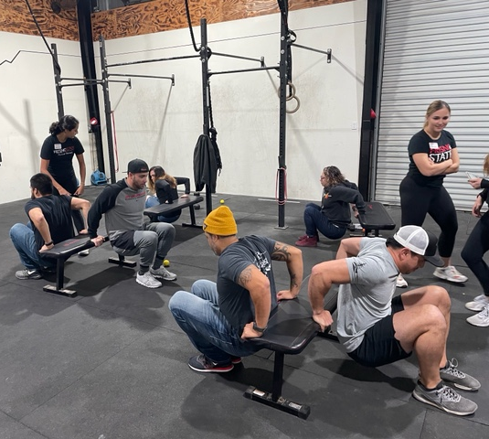
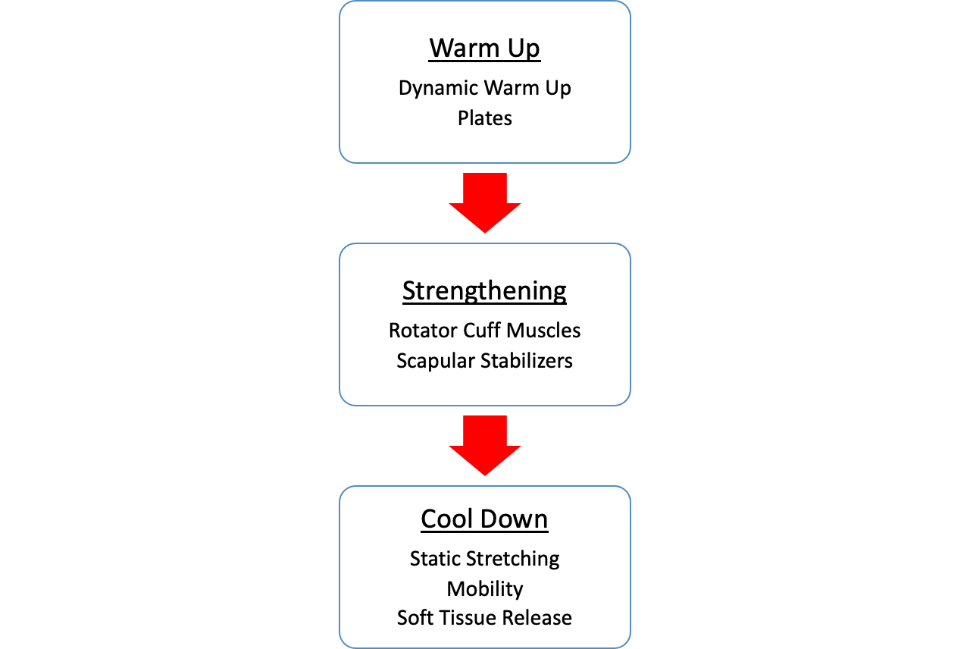
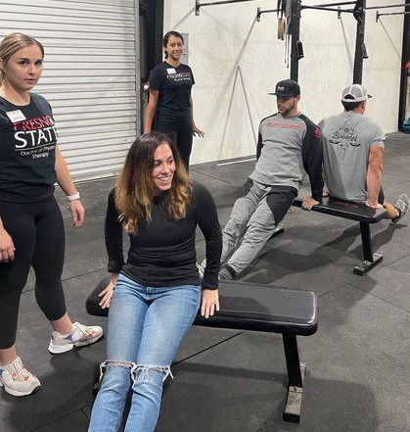
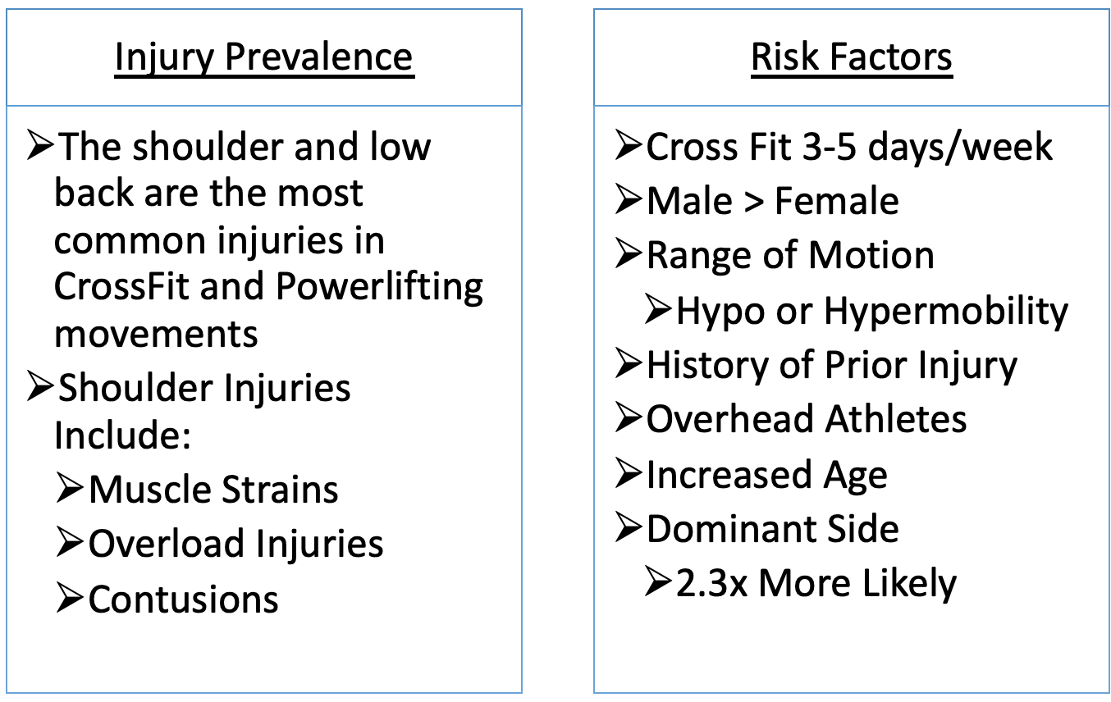
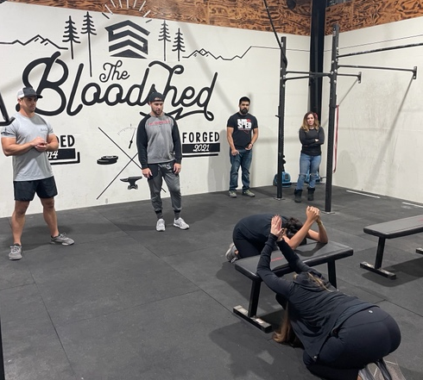
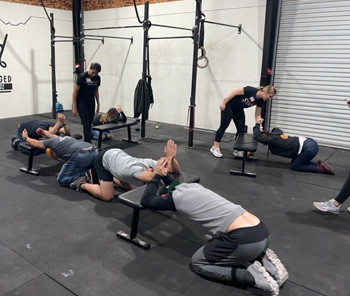
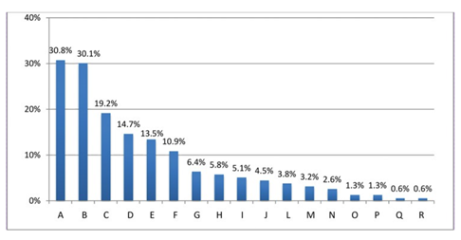
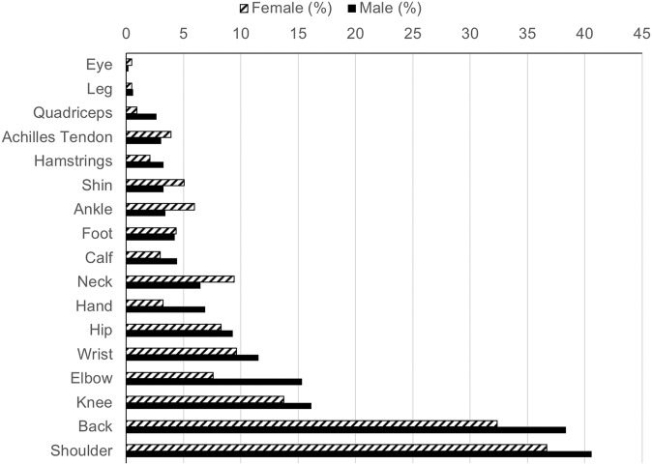
Shoulder Prehab and Education for the CrossFit Community
Rachel Christie SPT, Nadia Fahoum SPT, Megan Kravec SPT, Sabrina Pantoja SPT
Department of Physical Therapy
California State University, Fresno
Mission & Purpose
INTERVENTION
Key Points
The purpose of this service-learning project was to educate athletes in the CrossFit community on shoulder mechanics, injury prevention and provide sport specific prehab exercises for optimal movement.
Discussion & Reflection
This project provided an opportunity to enhance our knowledge of shoulder and scapular musculature and arthrokinematics. We were able to fine tune our understanding of the general anatomy and apply it to sequencing required for specific movements that affect overhead athletes in the CrossFit community. Throughout the project we learned the effectiveness of using population specific terminology and were able to modify our verbiage accordingly. We were very appreciative of the opportunity to share our knowledge, practice execution of interventions and multimodal cueing, and provide valuable shoulder prehab to the athletes at BloodShed.
Shoulder Injuries in CrossFit
Acknowledgements
Special thanks to BloodShed Strength and Performance for providing a platform for us to share our Shoulder Prehab Education Seminar.
For questions or additional information please contact:
rachelchristie@mail.fresnostate.edu |nfahoum@mail.fresnostate.edu
megankravec@mail.fresnostate.edu | srpantoja2@mail.fresnostate.edu
Body regions affected by injuries, A=Shoulder, B=Low Lumbar Spine, C=Leg, D=Wrist, E=Knee, F=Hand/Finger, G=Ankle, H=Thigh, I=Arm, J=Cervical Spine, L=Foot, N=Head/Face, O=Abdomen, P=Elbow, Q=Sternum/Rib/High Thoracic Spine, R=Forearm
Weisenthal et. al. 2014
Distribution of the location of injuries between male and female participants
Feito et. al. 2018

