Slide 1
Navigating the Thesis Template:
Shortcut keys
Presented by the
Graduate Writing Studio

Slide 2
Shortcut keys
Bypass Styles window
Select style (e.g., “thesis text”) from keyboard
Faster, more efficient formatting

Slide 3
Shortcut keys
In template, show Styles window (Alt+Ctrl+Shift+S)
Click drop-down arrow next to style in window
Select “Modify”
In “Modify Style” box, select “Format” in lower left corner
Drop down to “Shortcut key”
Assign shortcut key (e.g., Alt+M)

Slide 4
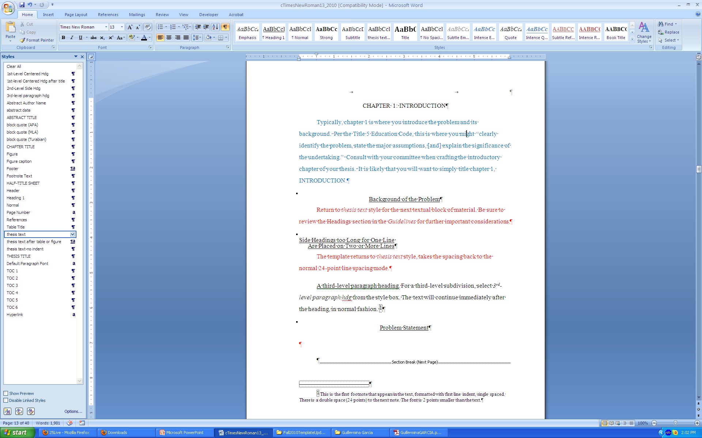
Drop-down arrow

Slide 5
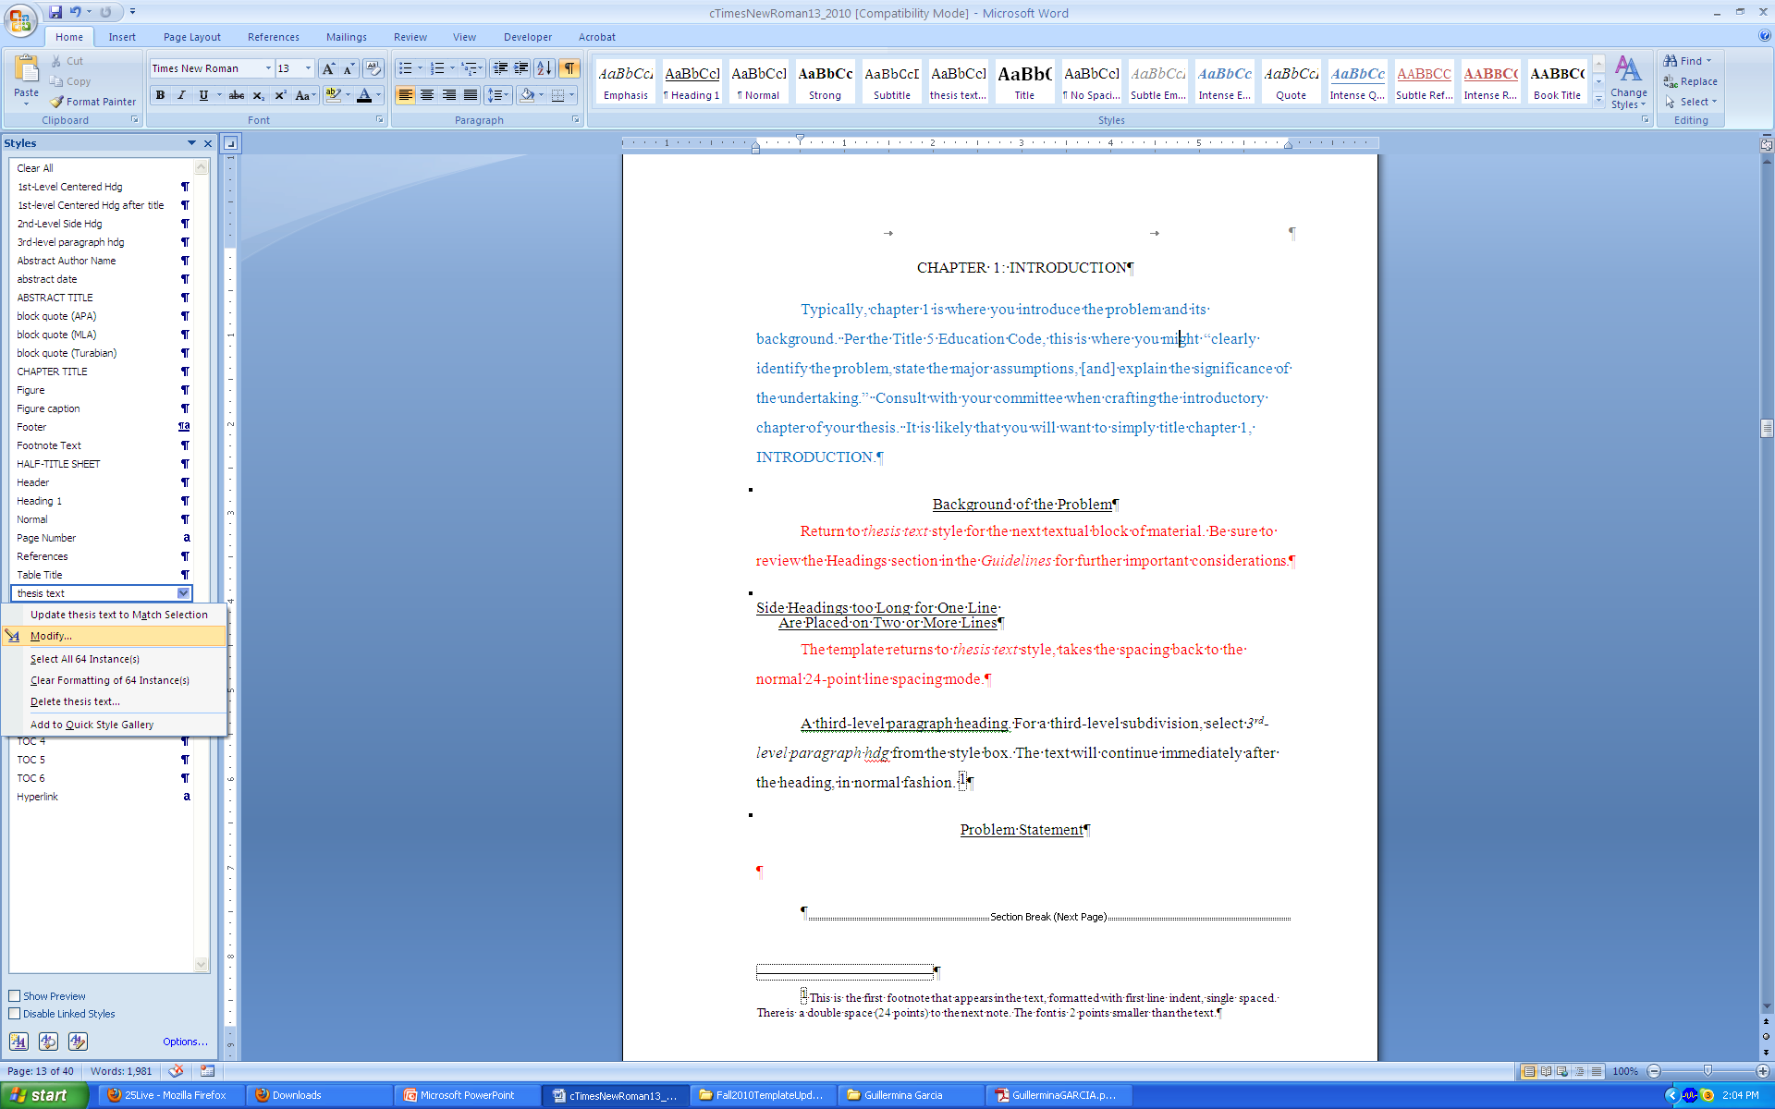
Select “Modify”

Slide 6
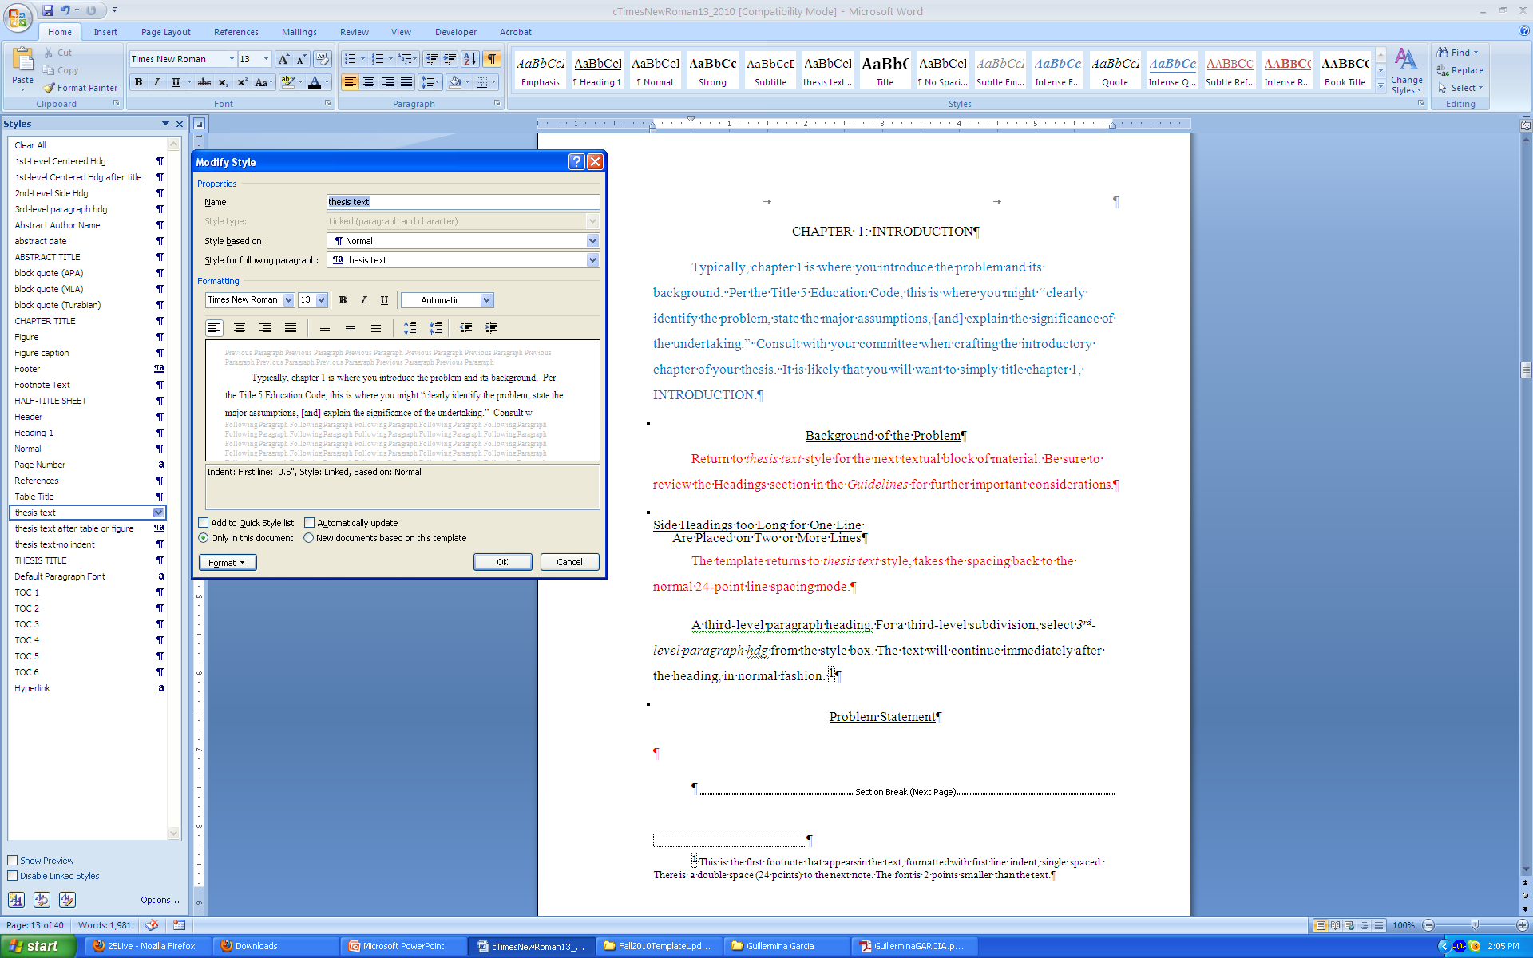
Click “Format”

Slide 7
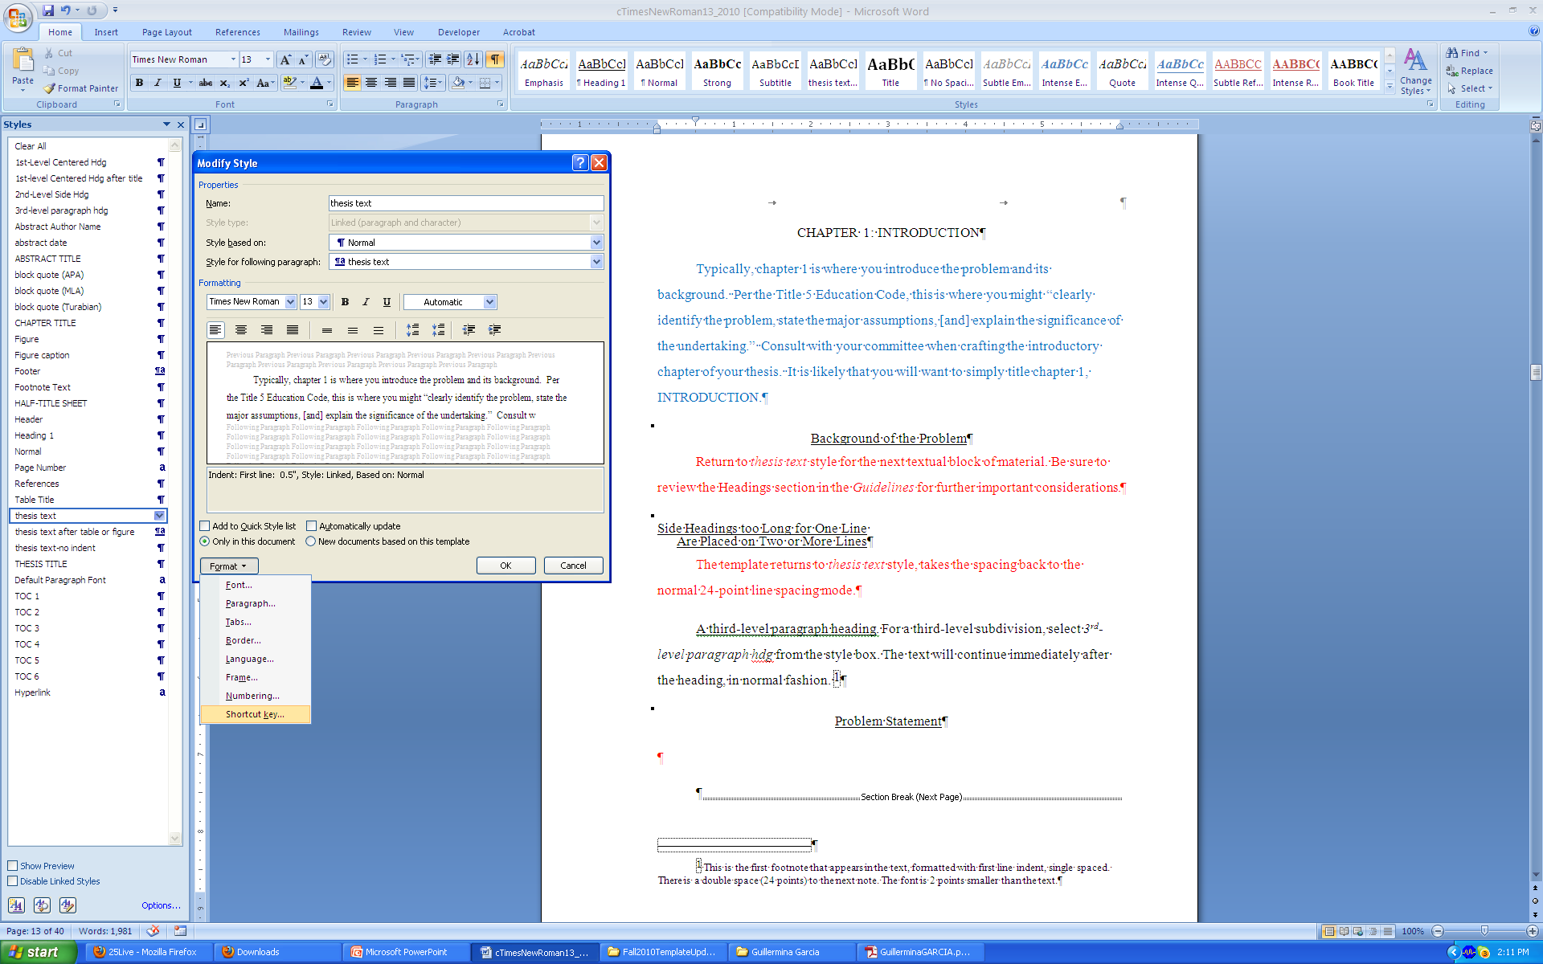
Select “Shortcut key”

Slide 8
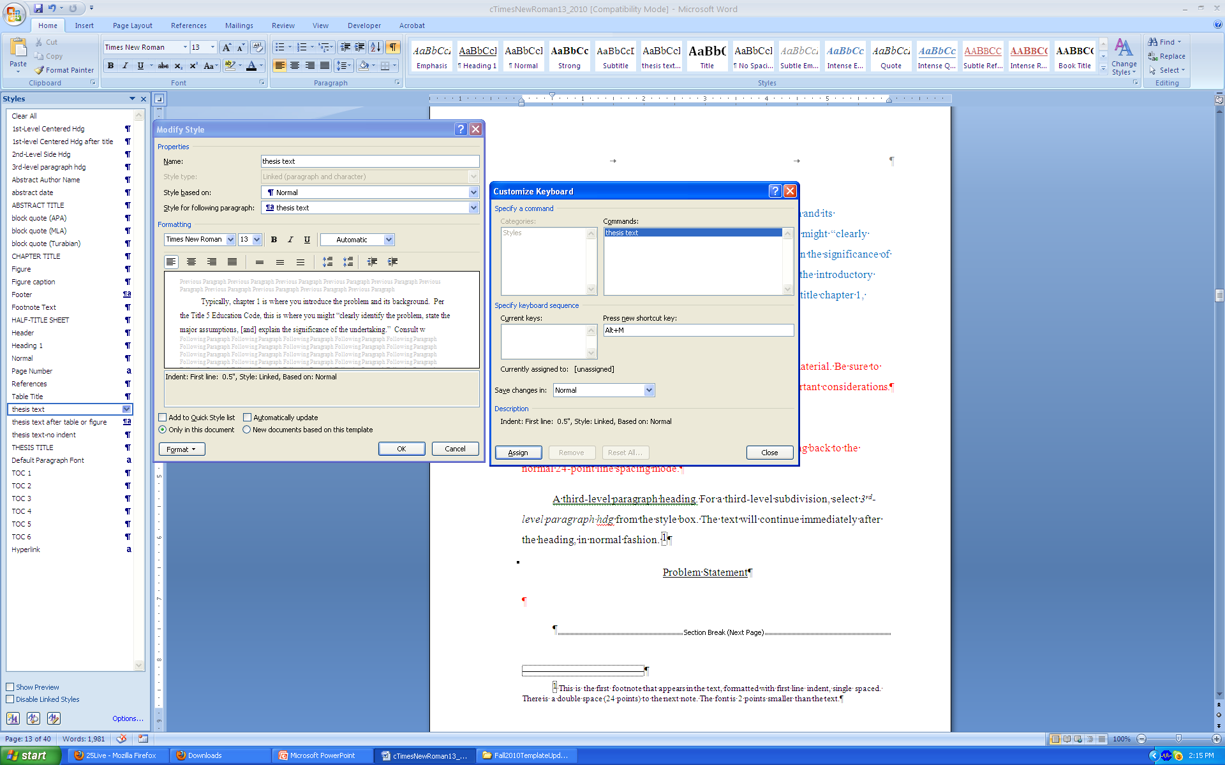
Press shortcut key (e.g., Alt+M)
Click “Assign”<“Close”

Slide 9

Click “OK” to finish

Slide 10
Congratulations!
Your keyboard is now customized!
1-2-3
Paste your original text into the template
Place your cursor in the paragraph(s) you want to format
Press your shortcut key to change the style to “thesis text”
Assign shortcut keys to any style you may use a lot (e.g., thesis text, 1st-Level Hdg)

