Slide 1
Mazie Moua
Academic Success Coaching Coordinator
maziem@csufresno.edu
559.278.6633

Slide 2
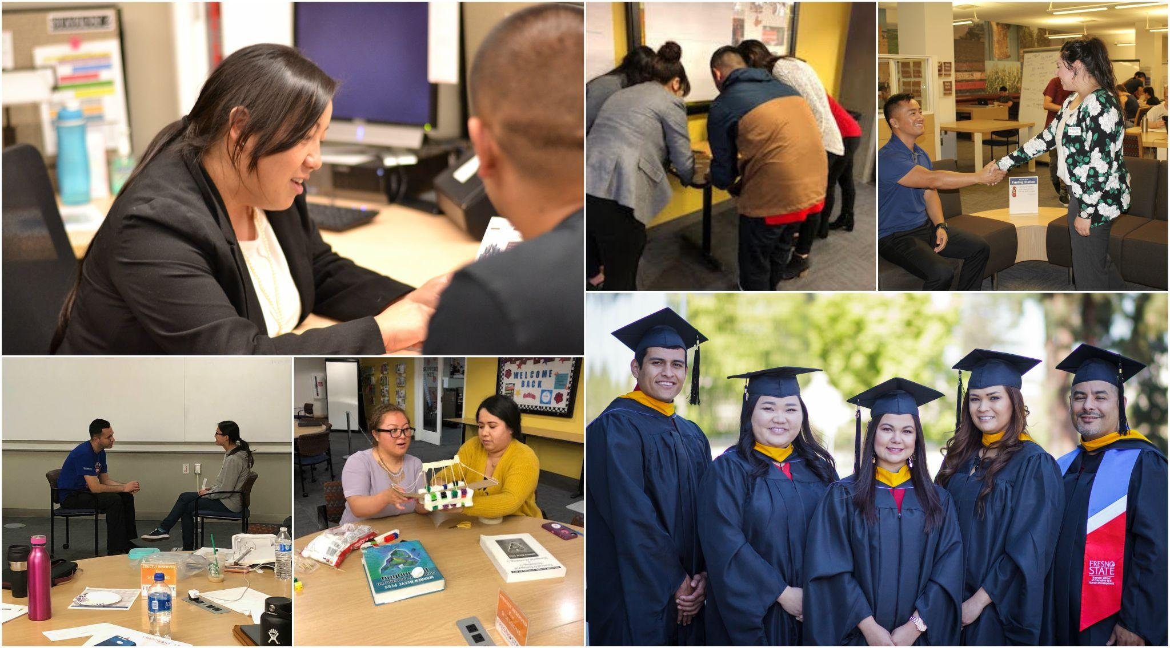
Coaching 1 student at a time
Academic Success Coaching (formerly known as SupportNet) provides coaching that focuses on the needs of students while leveraging a holistic approach to help students reach their fullest potential at Fresno State and navigate their college experience.
Students gain:
Time management strategies
Accountability partner
Note taking in both classroom and readings
Motivation
Connection with campus resources
More

Slide 3
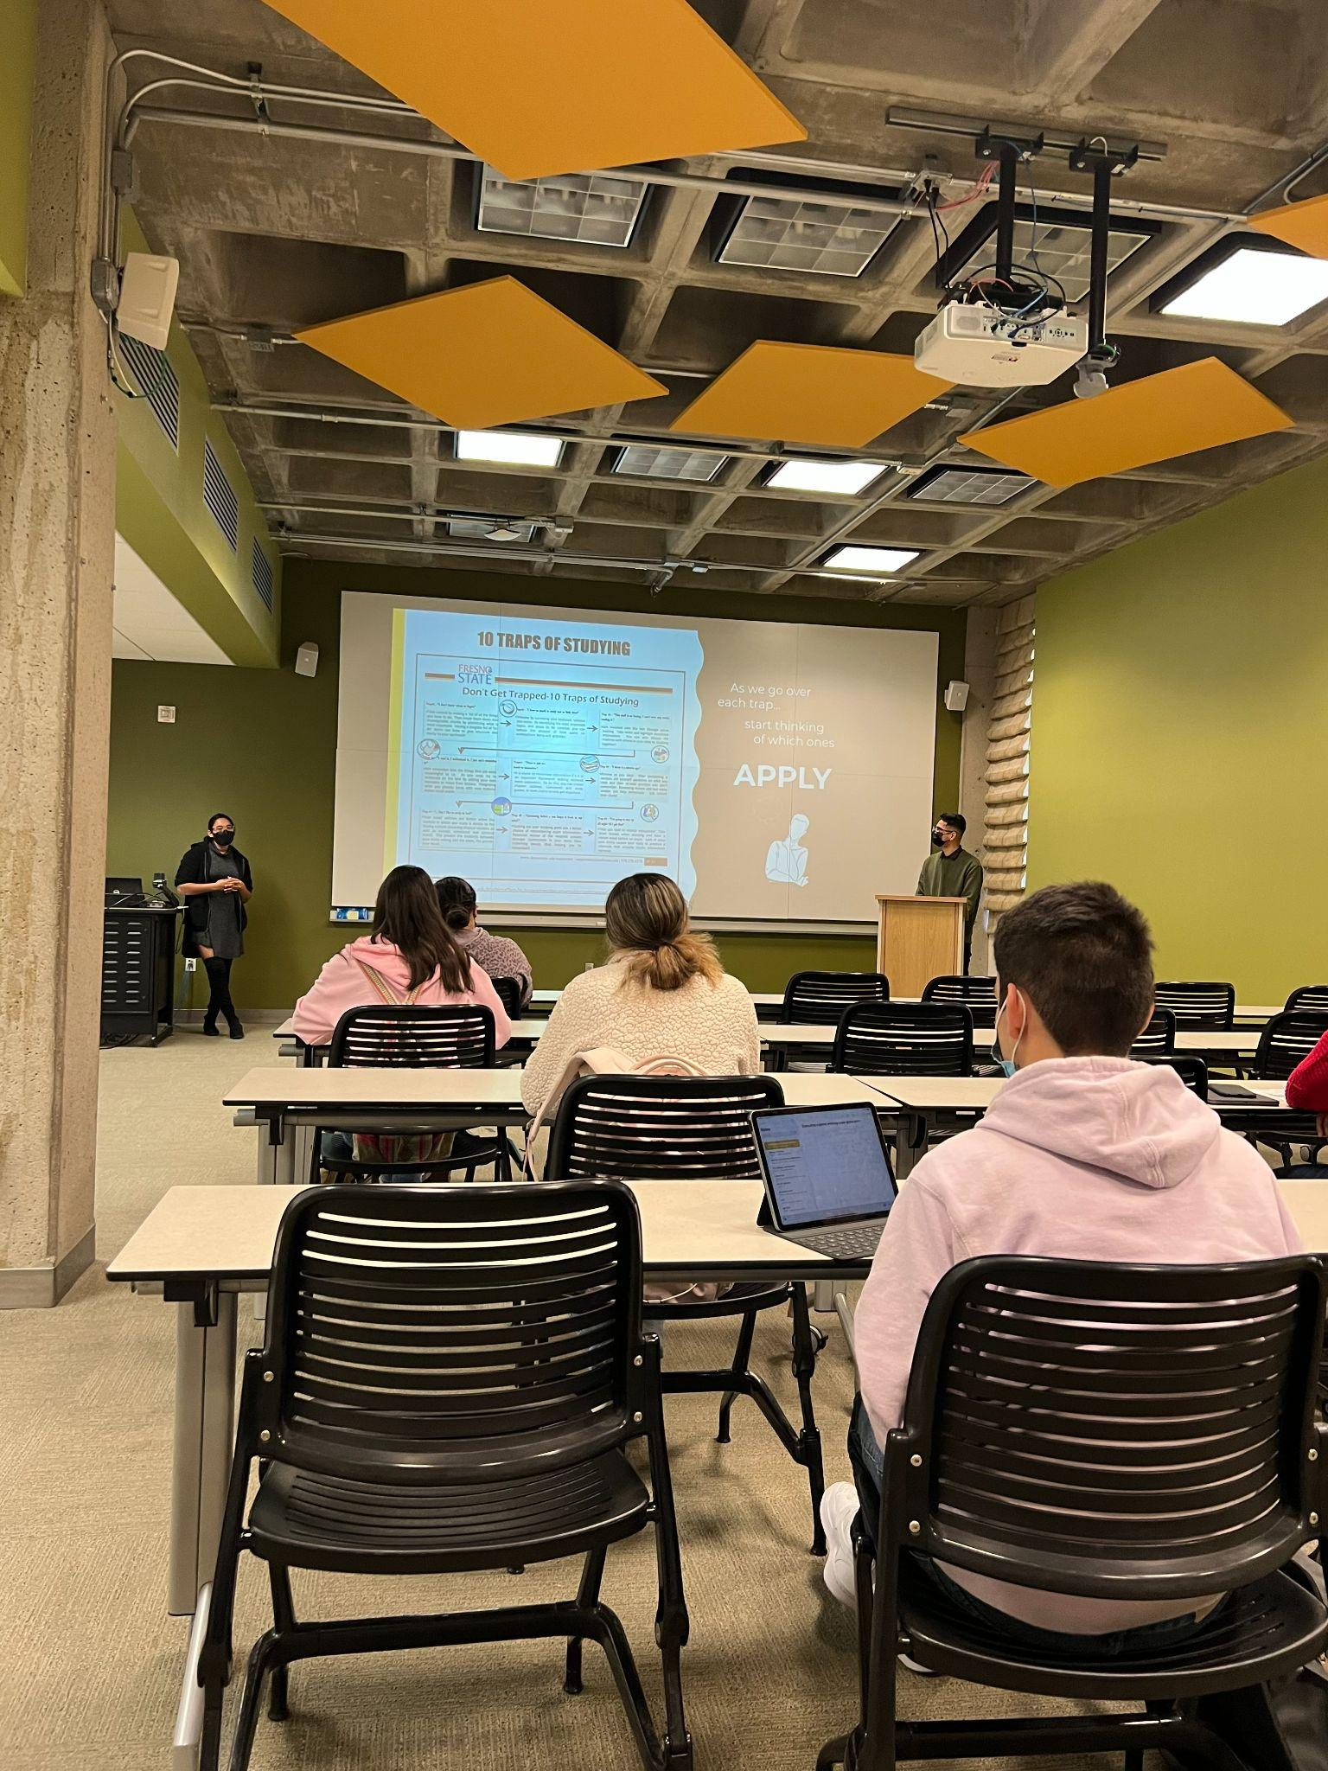
Invite Us Into Your Classroom
Academic Success Workshops are available to students both in person and online. Workshops can be requested for classrooms. Some workshops we provide:
Set, Follow, Achieve: S.M.A.R.T. Goal-Setting
A Time for Time Management
Motivation, Success and You
Me, Myself and I: Self-Care
Strategies for Success in the Online Learning Environment

Slide 4
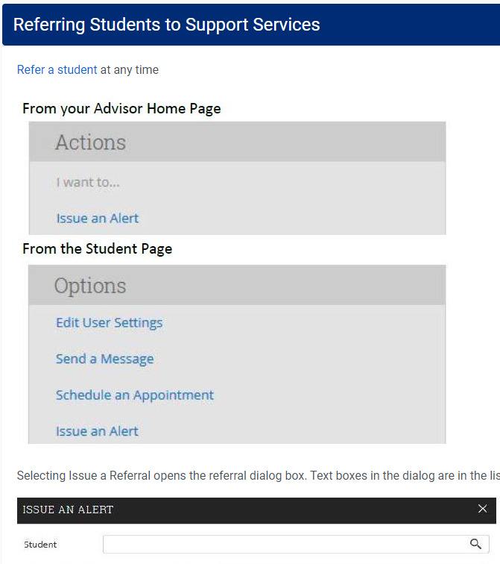
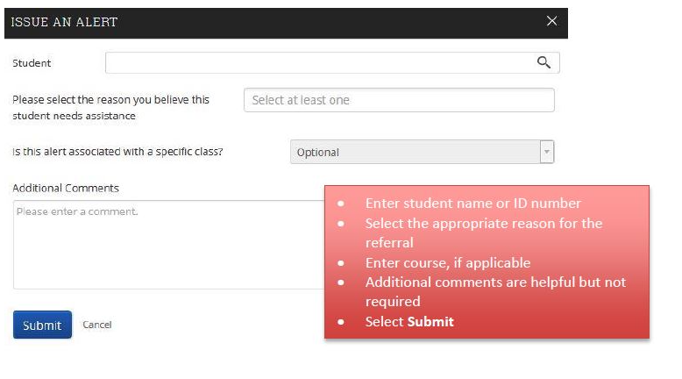
Students Served
Refer students anytime in the semester to A.S.C. through Bulldog Connect or by contacting our office at asc@mail.fresnostate.edu or 559.278.8370.

